Slide 1
Employee Data Analysis using Excel
STUDENT NAME: HARITHA H
REGISTER NO: 549B8057E0C14C58D8B4B4A8510E0565, 312208677
DEPARTMENT: B.COM(GENERAL)
COLLEGE: MEENAKSHI COLLEGE FOR WOMEN

Slide 2
PROJECT TITLE
Employee Analysis
Based On Departments

Slide 3


AGENDA
Problem Statement
Project Overview
End Users
Our Solution and Proposition
Dataset Description
Modelling Approach
Results and Discussion
Conclusion
3/21/2024 Annual Review

Slide 4

PROBLEM STATEMENT:
The total FTE for each employment type (Fixed Term, Permanent, Temporary).
The contribution of each employment type to the overall FTE.
Any potential recommendation for optimising the FTE distribution in the department.

Slide 5

PROJECT OVERVIEW
The project aims to analyse Full-Time Equivalent (FTE) distribution across different employment types within the accounting department.
The analysis will focus on fixed term permanent term and temporary roles, with the total FTE of 16.4.

Slide 6

WHO ARE THE END USERS?
Human Resource Departments
Management And Leadership
Team Leaders And Supervisors
Employees
Executive Leadership
Business Analysts
Recruiters

Slide 7

OUR SOLUTION AND ITS VALUE PROPOSITION
Filtering- Remove Values
Pivot Table - Summary Of Employee Analysis based on Department
Pie chart - Final Report

Slide 8
Dataset Description
EMPLOYEE DATA SET- NAN MUDHALVAN PORTAL
9 FEATURES IN EXCEL:
EMPLOYEE ID- ALPHANUMERIC(TEXT)
NAME- ALPHABETICAL(TEXT)
GENDER- ALPHABETICAL(TEXT)
DEPARTMENT - ALPHABETICAL(TEXT)
SALARY - NUMERICAL
START DATE - ALPHANUMERIC(TEXT)
FTE- NUMERICAL
EMPLOYEE TYPE- ALPHABETICAL(TEXT)
EMPLOYEE LOCATION- ALPHABETICAL(TEXT)
3 FEATURES USED:
DEPARTMENT - ALPHABETICAL(TEXT)
FTE- NUMERICAL
EMPLOYEE TYPE- ALPHABETICAL(TEXT)

Slide 9

THE "WOW" IN OUR SOLUTION
The precise distribution of FTE employees, with the permanent roles dominating at 10.8 out of 16.4 total FTEs.
Despite, a relatively small team, the blend of fixed term (4FTEs) and temporary (1.6 FTEs) staff highlights a strategic approach to workforce management within the accounting department.
Well-presented data can have a significant impact on decision-makers, helping to drive change and innovation.
3/21/2024 Annual Re
view
9

Slide 10
MODELLING:
Step -1
Download the employee dataset and open the employee dataset in excel.
Step -2
Select the entire data and click on data and click on filter option.
Step -3
Filter ftp from A to Z order.
Step -4
Select the entire data and click on insert and click on pivot table to create pivot table.
10

Slide 11
Step -5
Drag the needed data and create a pivot table.
Step -6
Select the pivot table and click on insert.
Step-7
Now click on the chart that you want.
Step -8
The chart is created.

Slide 12
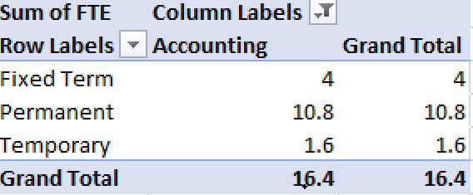
RESULTS:
1. TABLE
12

Slide 13
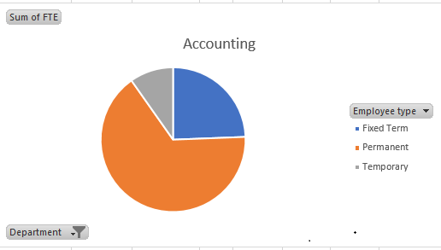
2. PIE CHART

Slide 14
Conclusion:
The dataset reveals that the Accounting department’s workforce is predominantly composed of Permanent employees, who make up 10.8 of the total16.4 Full-Time Equivalent(FTE) positions.
The remaining workforce is supplemented by 4 FTEs in Fixed Term roles and 1.6 FTEs in Temporary roles.
This staffing structure indicates a reliance on a stable, long-term workforce with strategic use if temporary and fixed term staff to meet fluctuating needs or specific projects.
This balanced approach allows foe both continuity and flexibility within the department.

